Slide 1
How healthy is your Water Body?
Get the score card to make your favorite water body the best.

Slide 2

Use case diagram
Wishes to
compare data
with other year
or water
Submits answers to
the questions
Yes
No
Calculate
scorecard
Display Graph

Slide 3
Calculation
pH : 6.5 to 9
DO : Calculated based on the fishes living in water.
NH3: As pH n Temperature increases, ammonia content increases.

Slide 4
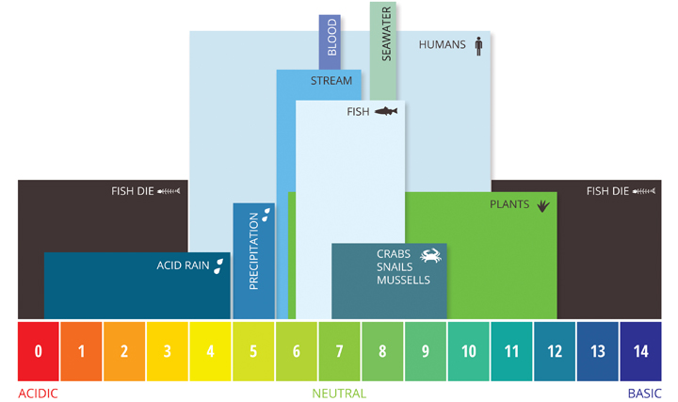
pH Chart

Slide 5
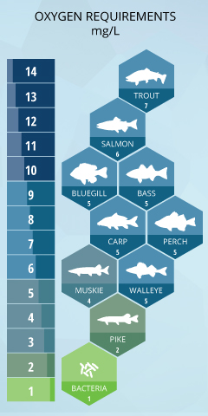
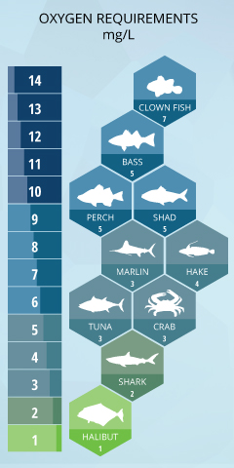
DO Chart :

Slide 6
Overall Architecture
Web Response
Mobile Response
Integration Layer
DB

Slide 7
Sample Demo
GITHUB LINK : https://github.com/NiranjanaaR/Grid_Interview.git

Slide 8


